Slide 1
Form processing

Slide 2
▪ $_GET
▪ $_POST
▪ $_REQUEST

Slide 3
$_GET and $_POST
PHP loads the values for the URL parameters into an array called $_GET and the POST parameters into an array called $_POST
There is another array called $_REQUEST which merges GET and POST data

Slide 4
HTML FORM
▪ HTML forms are used to pass data to a server via different input controls.
All input controls are placed in between <form> and </form>
Syntax
<form action=“PagetoOpen ” method=“ ” >
//input controls placed here
</form>
Method= GET or POST
3

Slide 5
SAMPLE HTML FORM

Slide 6
Sample html form

Slide 7
Passing Parameters to The Server
GET /simpleform.html?yourname=fred
Accept: www/source
Accept: text/html
User-Agent: Lynx/2.4 libwww/2.14
Web Server
HTTP
Request
POST /simpleform.html
Accept: www/source
Accept: text/html
User-Agent: Lynx/2.4 libwww/2.14
Content-type: application/x-www-form-urlencoded
Content-length: 13
yourname=fred
Browser
<input type="text" name="yourname" id="yourid" />

Slide 14
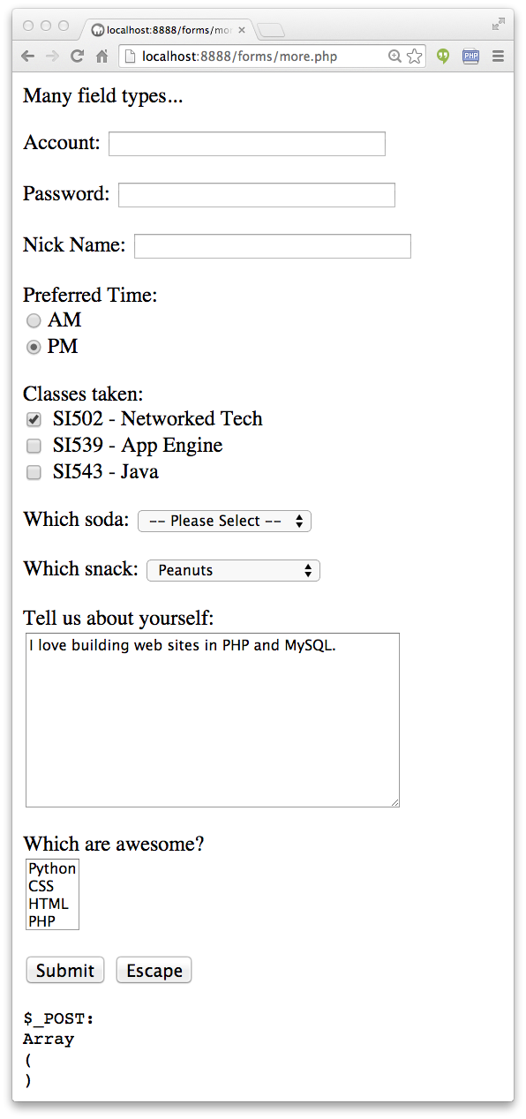
Other Input Types
Text
Password
Radio Button
Check Box
Select / Drop-Down
TextArea

